Slide 1
Worldwide Healthcare Power BI Report

Slide 2
Data Processed in These Steps
Data Objectives
Data Cleaning
Table Normalization
Data Processing & DAX
Dashboard & Insight
Export and Share the Project

Slide 3
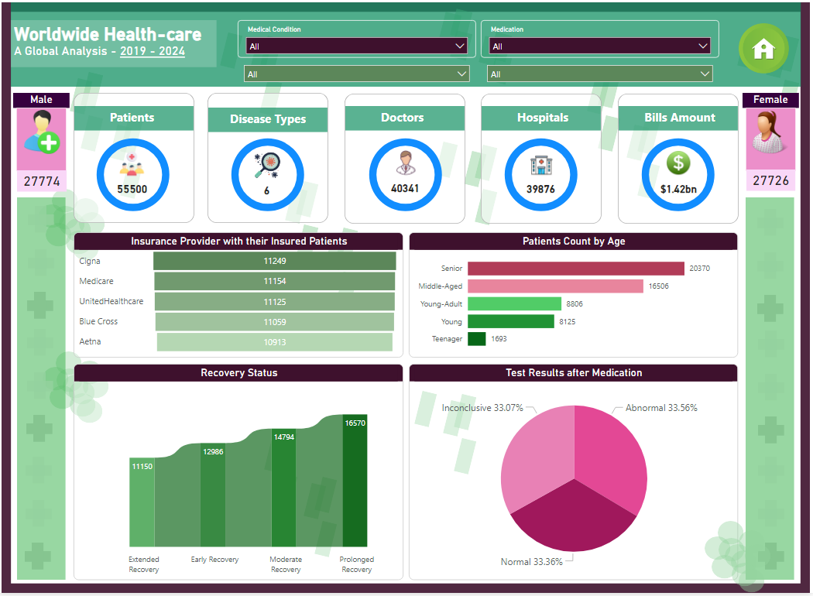
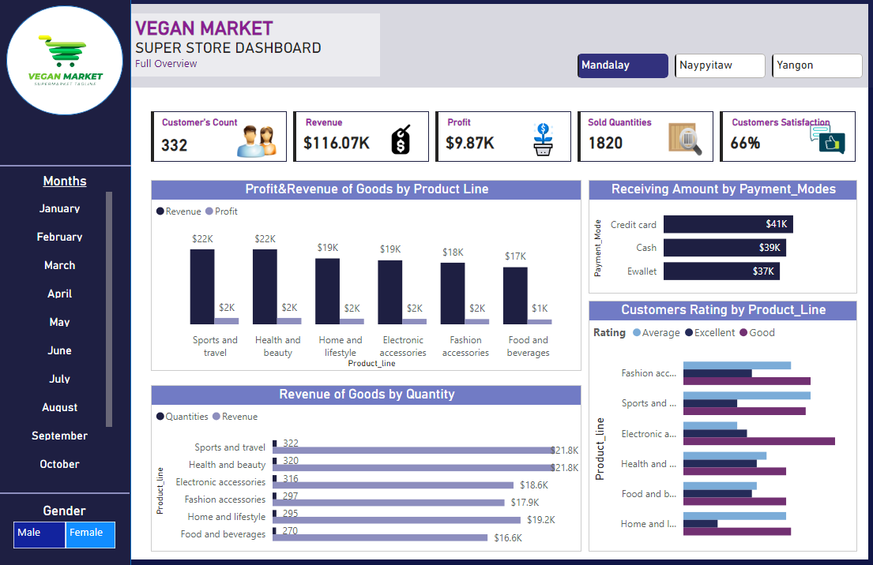
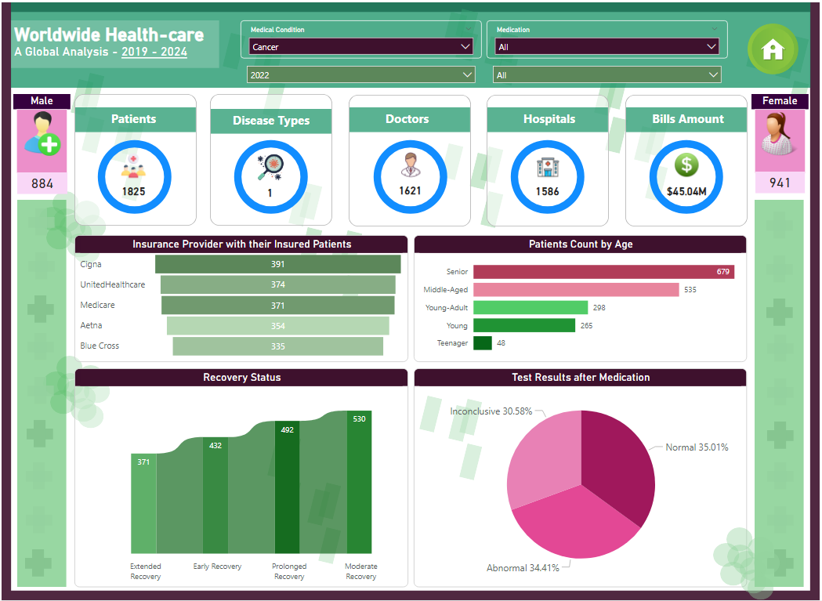
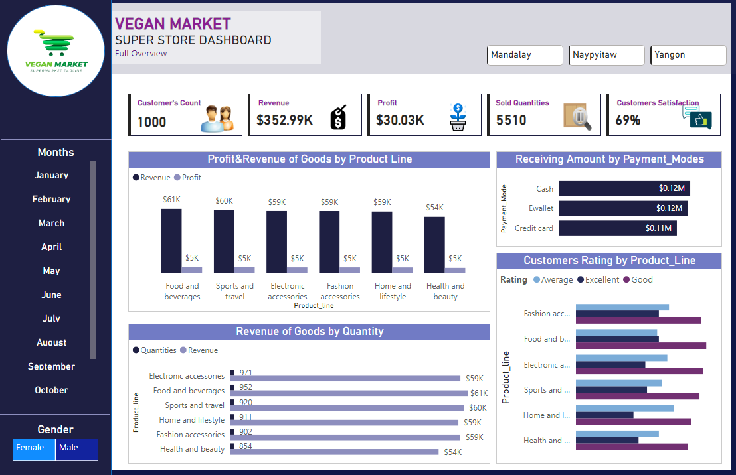
Power BI Projects

Slide 4
Objective
To develop a comprehensive “Healthcare” dashboard.
It provides real time insights into key performance metrics and trends, enabling stakeholders to monitor and analyze healthcare operations effectively.
Download Data:
https://github.com/amalikhan6110 LinkedIn Profile:
https://www.linkedin.com/in/hafiz-muhammad-ali-25a1aa227/

